Slide 1

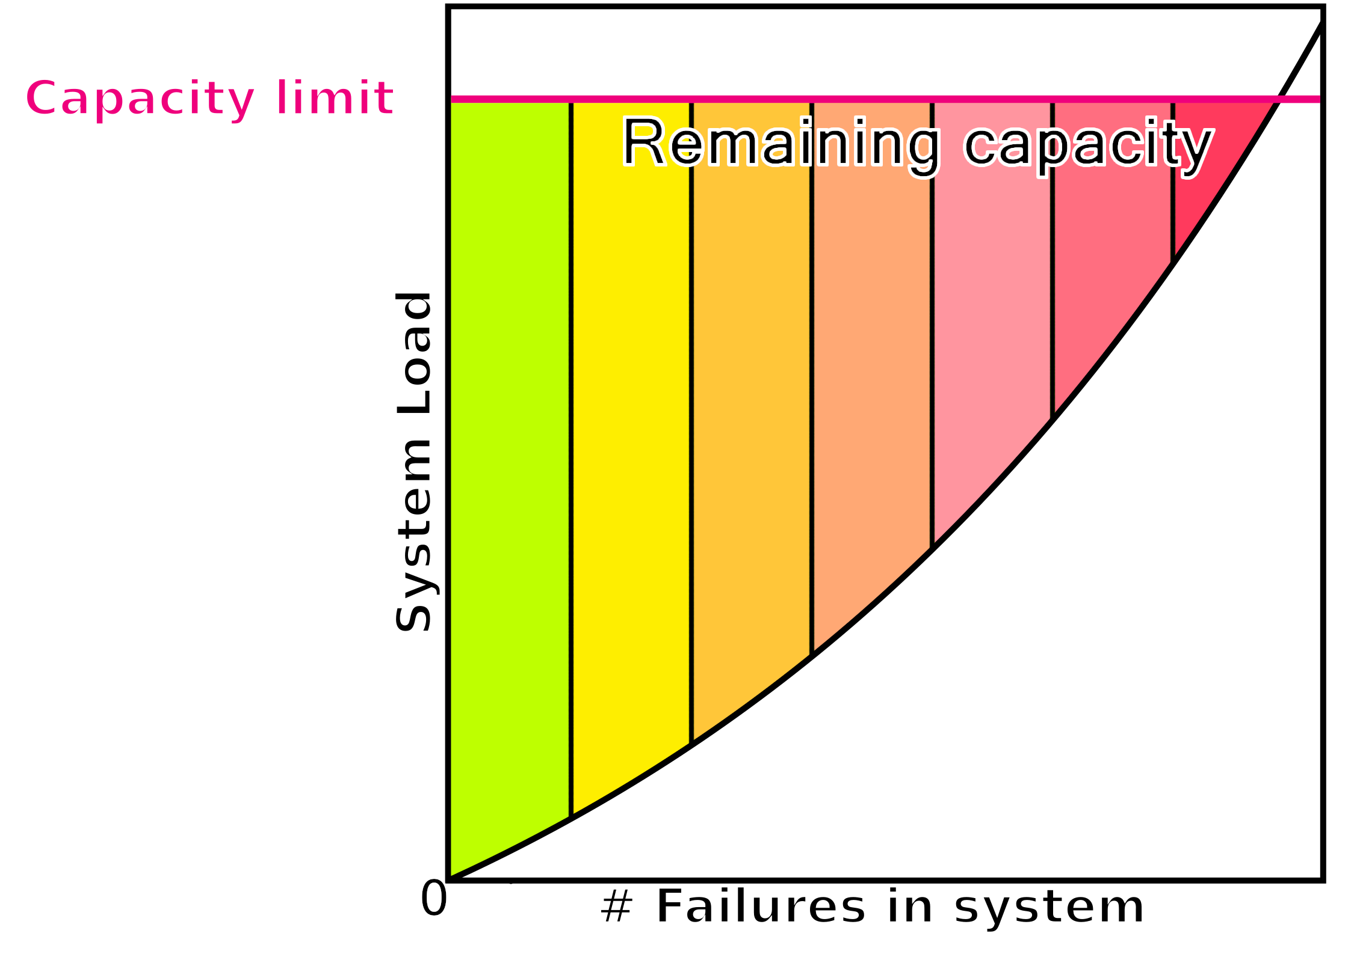
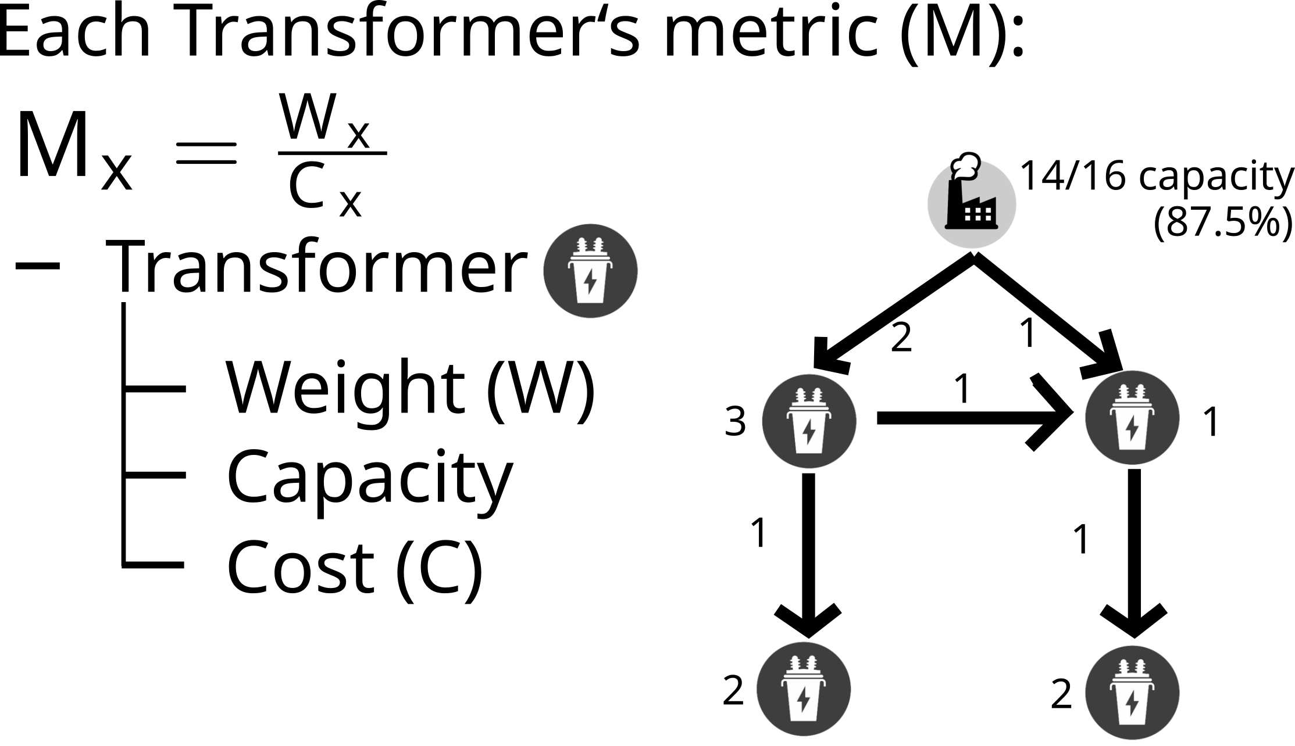
Power Grid Cyberattack Analysis
Wyatt Ward, Mitchell Lehman, and Andrew Nyffeler advised by Tu Nguyen
Sponsored by the PFW Department of Computer Science
Abstract
Method
Discussion / Future works
Modern smart electrical grids may be vulnerable to exploitation or sabotage; this analysis attempts to create a way (metric) for identifying the most likely attack targets for a given smart grid to trigger a "domino effect."
As more points on the grid fail, the available carrying capacity of remaining points shrinks while they shoulder the burden normally carried by the failed parts.
Much as the grid itself has a maximum load it can carry, so too does every part of a system. As more parts fail, the remaining parts' operating margins shrink. So by taking down one or two cheaper parts, the remaining cost for attacking a previously expensive piece might become feasible.
While we have found our methods for determining how desirable parts of a grid would be for attackers, If this project is continued moving forward, it would be prudent to create a formal computerized algorithm which can operate on these principles more quickly and efficiently than the manual calculations that have been used so far.
Additionally, it would be interesting to add more qualities of a grid, like inductance and capacitance of power lines, which much more severely impacts longer power cables than shorter ones and tangentially impact their resistance (which is the most major factor, and one this project has already accounted for). This would give the model a more "true-to-life" representation of real world systems.
Introduction
A modern electrical grid is different from its earlier forbears; it possesses sensors and computer systems that can choose to route power to quickly restore operation in the event of failure of a few components (making it "smart").
However, this might be exploitable for a potential attacker, as happened in Ukraine in late 2015. By intelligently choosing which parts of a grid to attack, one may be able to cause a "domino effect" which can potentially cause large swaths of the grid to go offline.
Such attackers need to operate within the budgets they have; this means making everything they attack count as much as possible, with minimal waste.
Our project sought to find a method to predict what points can be used to trigger a domino effect, accounting for the varying costs of attacking a given part.
System Design
Our model uses elements of graph theory to analyze smart grid networks to demonstrate the effects an attack can have on the system, even with limited resources.
Conclusion
Power systems in today's world are seen as quite durable and resilient, only resulting in blackouts from thunderstorms and high winds.
Our analysis has revealed that their underlying structure does not fit this stereotype, and that electrical grids can be attacked in such a way that effort sustained can result in proportionately larger results to designated targets.

